Slide 1
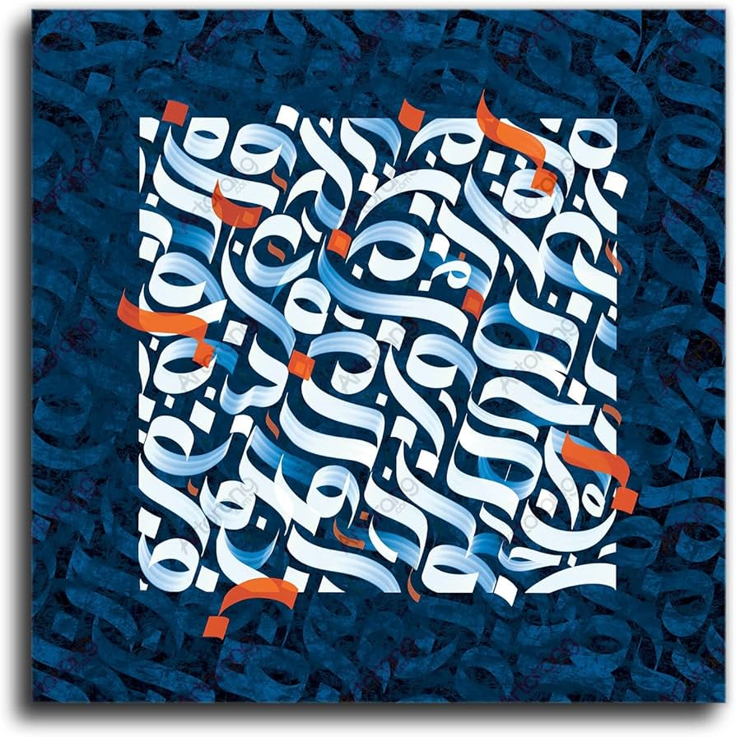
Persian Language
Farnaz Pirasteh
2nd year PhD candidate in CIS
FEIT Festival of Languages
Friday 20 February 2026

Slide 2
Who am I?
Doing my PhD in CIS, Information Systems
Research in Social Media Analytics, focusing on Influencers
Tutor in CS, TA at the Science Gallery
GSA Research Officer

Slide 3
Where Is Persian Spoken?
Persian is spoken by over 120 million people Mainly in:
Iran (Farsi)
Afghanistan (Dari)
Tajikistan (Tajik)
Different accents — same language 🤝

Slide 4
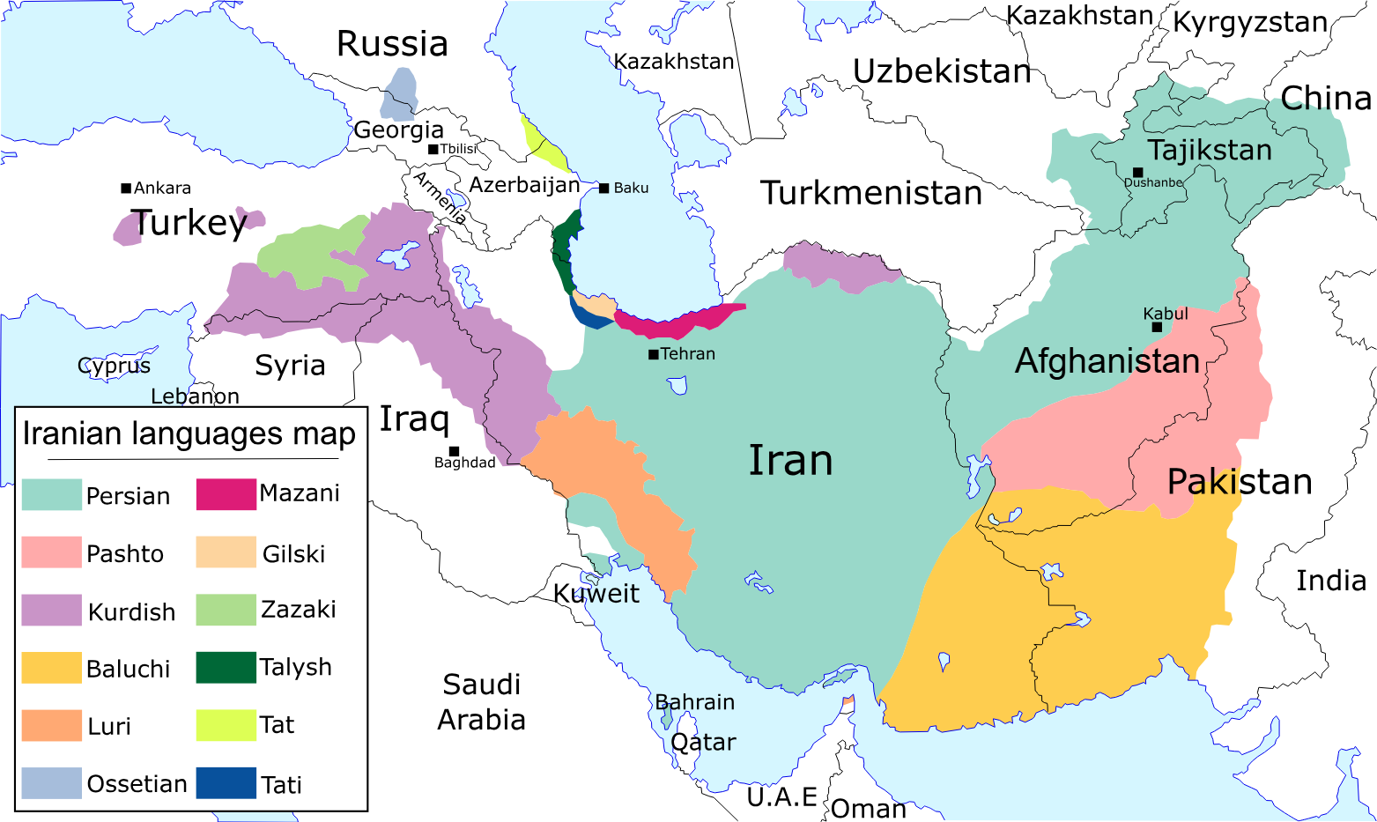

Slide 5
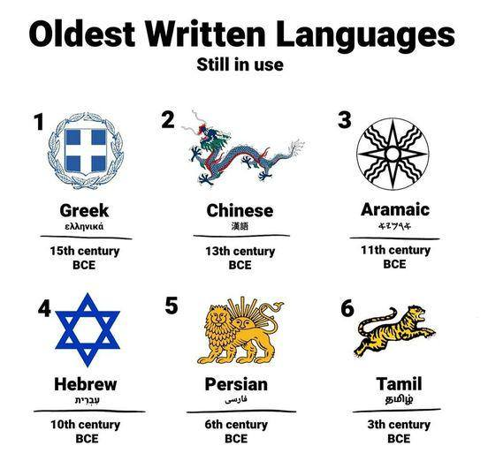
One of the Oldest Living Languages
Persian is one of the oldest living languages in the world 📜 Over 2,500 years old Still spoken, still evolving, still alive

Slide 6
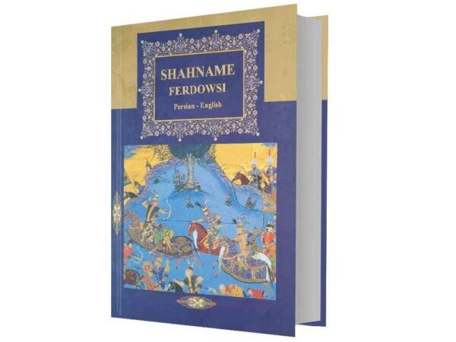
A Language of Culture & Poetry
Persian is famous for:
Poetry & storytelling
Music & everyday expressions
Warm, emotional communication
Fun fact: Persian poetry is still quoted in daily life 💬

Slide 7
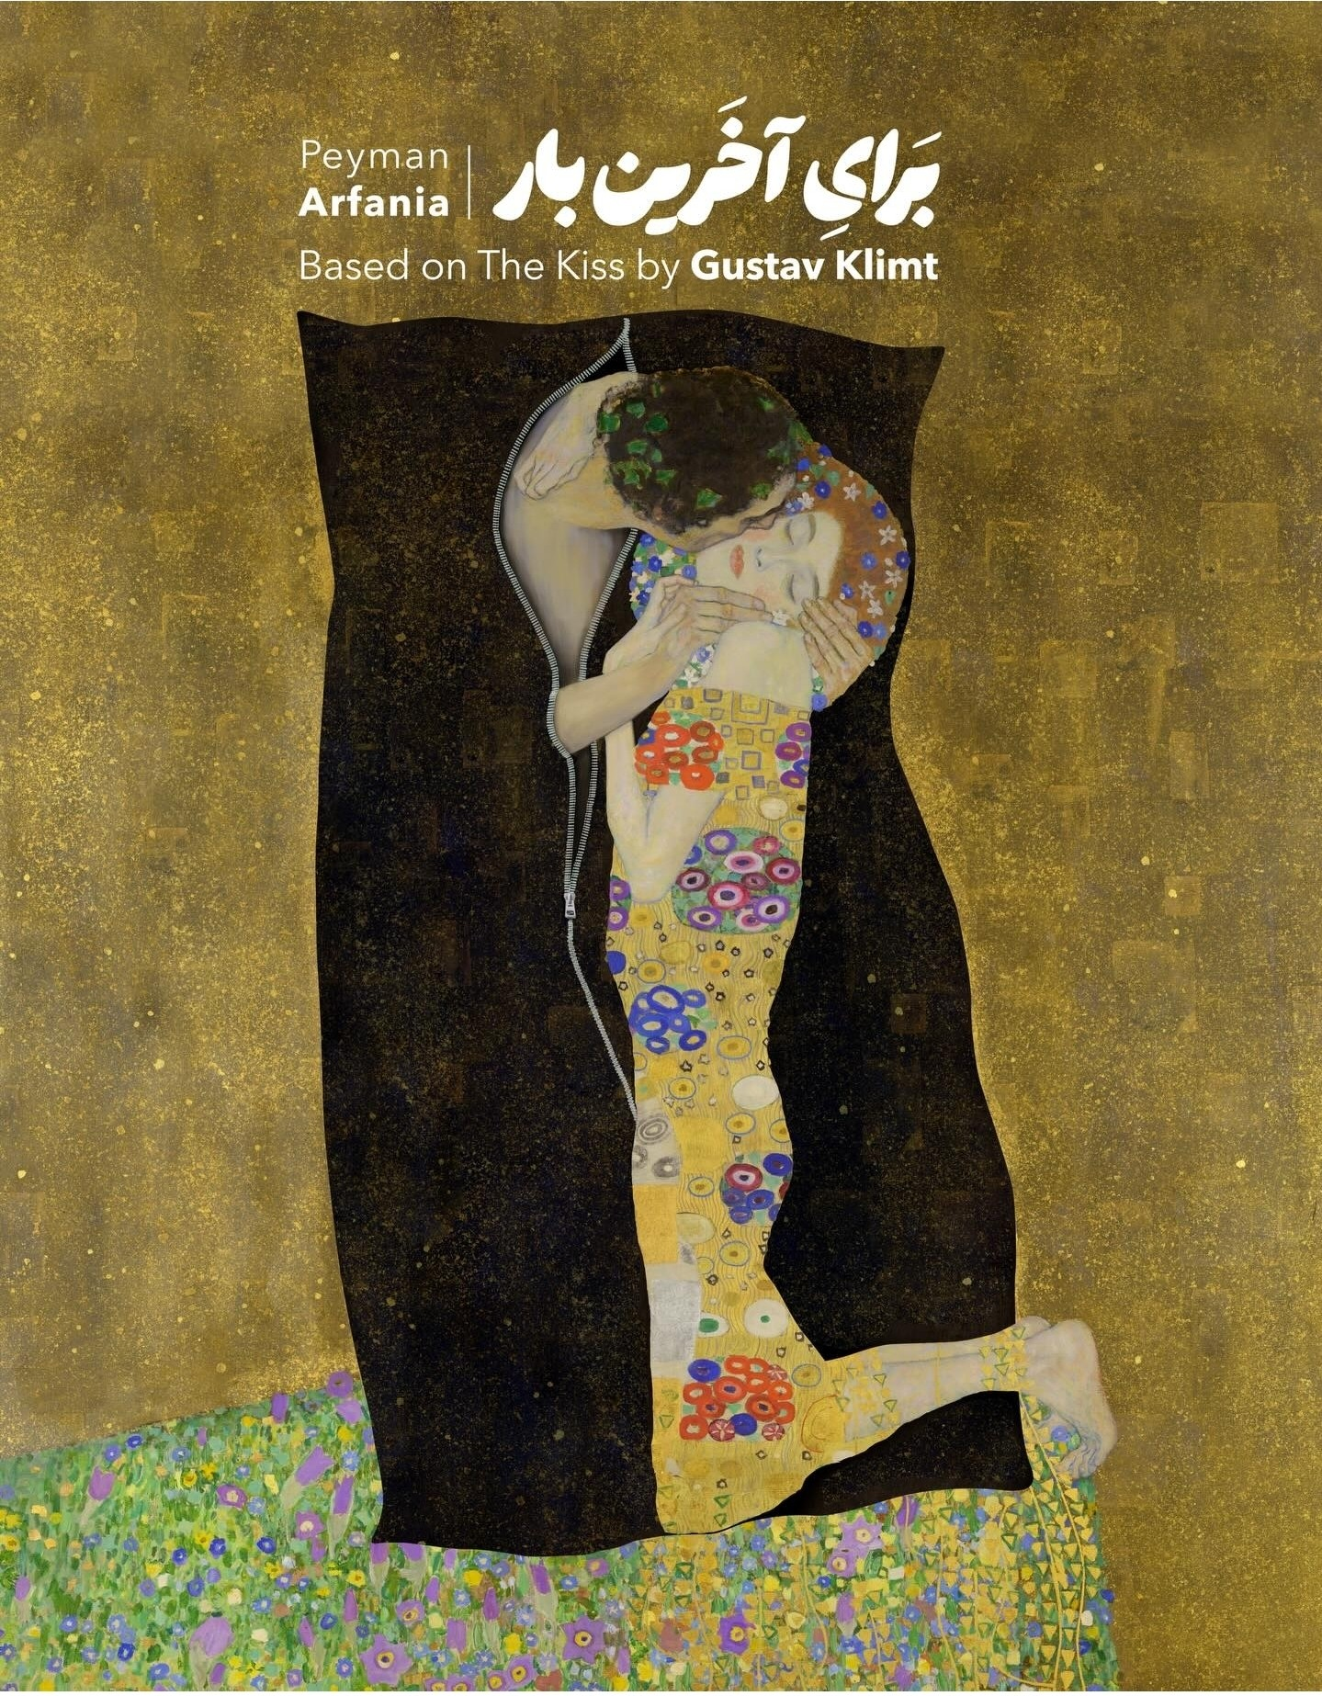
I would like to acknowledge the people of IRAN!
It’s not about politics — it’s about humanity.

Slide 8
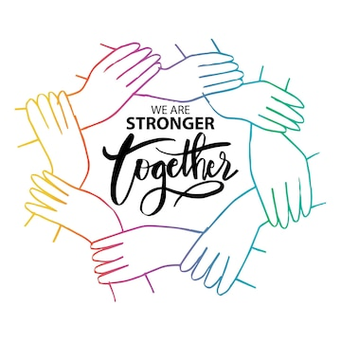
We are stronger together ☺
If you have an Iranian in your group,
please know that they mostly are not OK.
Please reach out, and support in your capacity.

Slide 9

Fun Facts about Persian ☺
Persian is written from right to left ➡️⬅️
Persian uses the same alphabet family as Arabic, but it’s a different language
Persian has no grammatical gender (no he/she for objects!)
Many English words come from Persian, like “pajamas,” “lemon,” and “bazaar”
Persian speakers often use poetry in everyday conversations

Slide 10
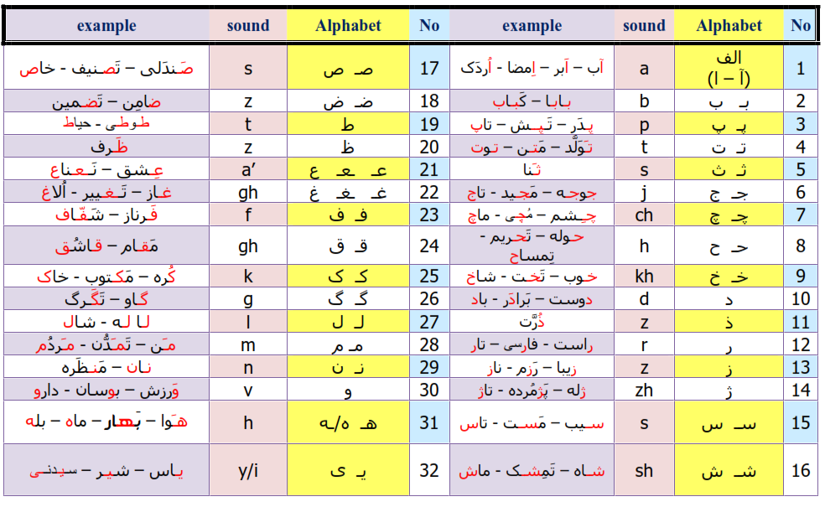
How many alphabets?

Slide 11
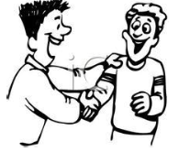
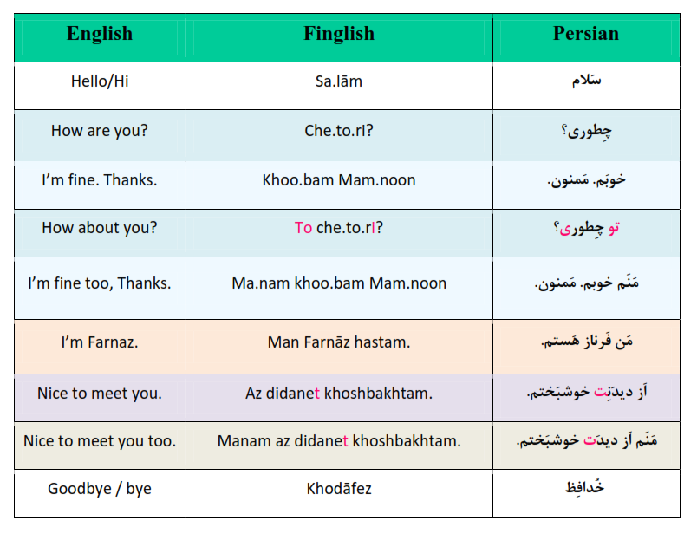
Let’s Try Persian!

Slide 12
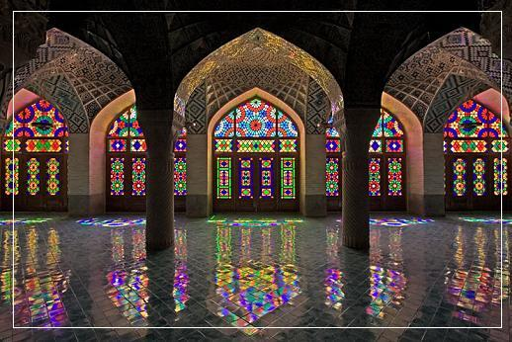
Iran
The land of Art, Beauty and Poetry!

Slide 13
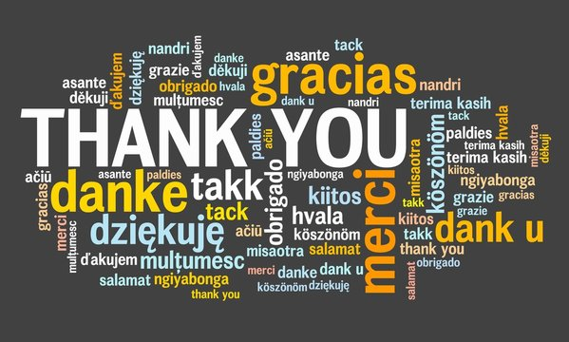

Slide 14
I would like to acknowledge the people of IRAN!
It’s not about politics — it’s about humanity:
Since January 2026 (Dey 1404),
in just two days of nationwide protests, the authorities of the
Islamic Republic of Iran carried out a brutal massacre against
civilians expressing their grievances.
During this period, the government completely shut down the internet,
cutting off all information and preventing the world from seeing the scale
of the violence. According to multiple reports, as many as 36,500 people
have been killed, including at least 144 children confirmed by UNICEF.

Slide 15
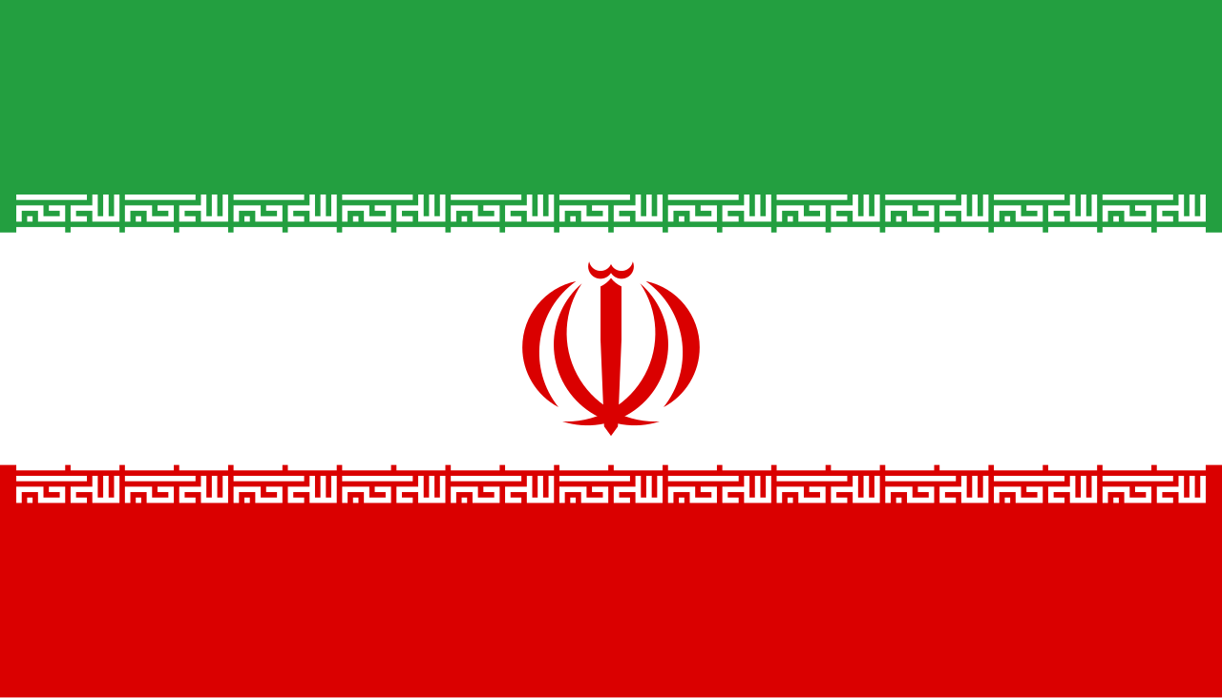


Slide 16
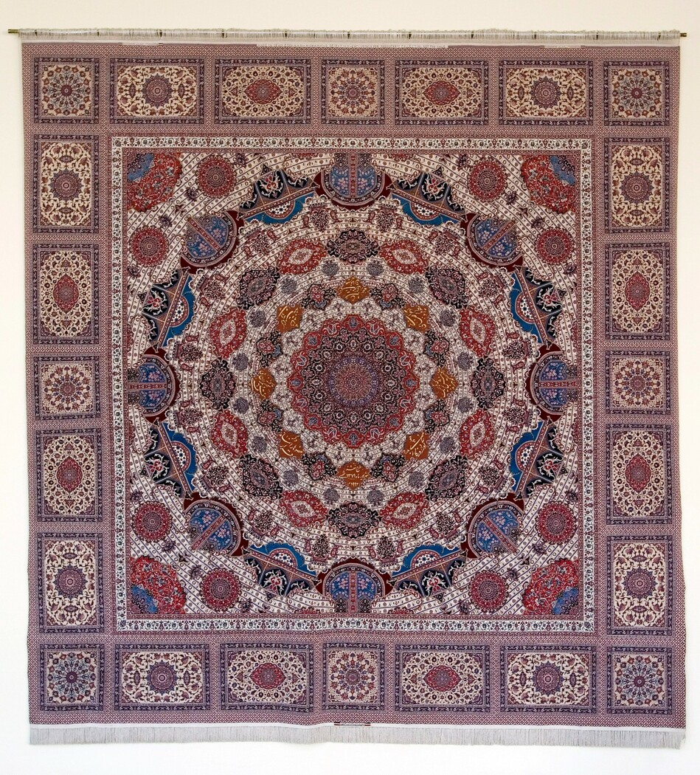
The poem is also inscribed on a large hand-made carpet installed in 2005
on the wall of a meeting room in the United Nations building in New York.
"Human Beings are members of a wholeIn creation of one essence and soulIf one member is inflicted with painOther members uneasy will remainIf you have no sympathy for human painThe name of human you can not pertain"
بنی آدم اعضای یک پیکر اند که در آفرينش ز یک گوهرند
چو عضوى به‌درد آورَد روزگار دگر عضوها را نمانَد قرار
تو کز محنت دیگران بی‌غمی

